Slide 1
Superstore Sales Dashboard Analysis

Slide 2
Dataset Overview
SUPERSTORE SALES DATASET
This dataset contains sales transactions from a retail superstore, capturing the full journey from order to fulfillment across customers, products, and regions.
TOOL USED
PBI
Microsoft Power BI
DATASET INCLUDES
Orders
Customers
Products
Sales
Used to model relationships, build DAX measures, and design the interactive dashboard for this analysis.
Profit
Region
Category
Order Date
2

Slide 3
Business Problem
The objective of this project is to analyze sales performance and identify key business insights that help decision-makers improve profitability and sales performance.
BUSINESS QUESTIONS
Which region performs best?
Which category generates the highest sales?
1
2
Which products are underperforming?
How do sales change over time?
3
4
3

Slide 4
KPIs Defined
Snapshot of overall performance across the Superstore dataset
2.30M
286.40k
5K
12.47 %
TOTAL REVENUE
TOTAL PROFIT
TOTAL ORDERS
PROFIT MARGIN
West
Technology
46.88%
TOP REGION
BEST-SELLING CATEGORY
SALES GROWTH
4

Slide 5
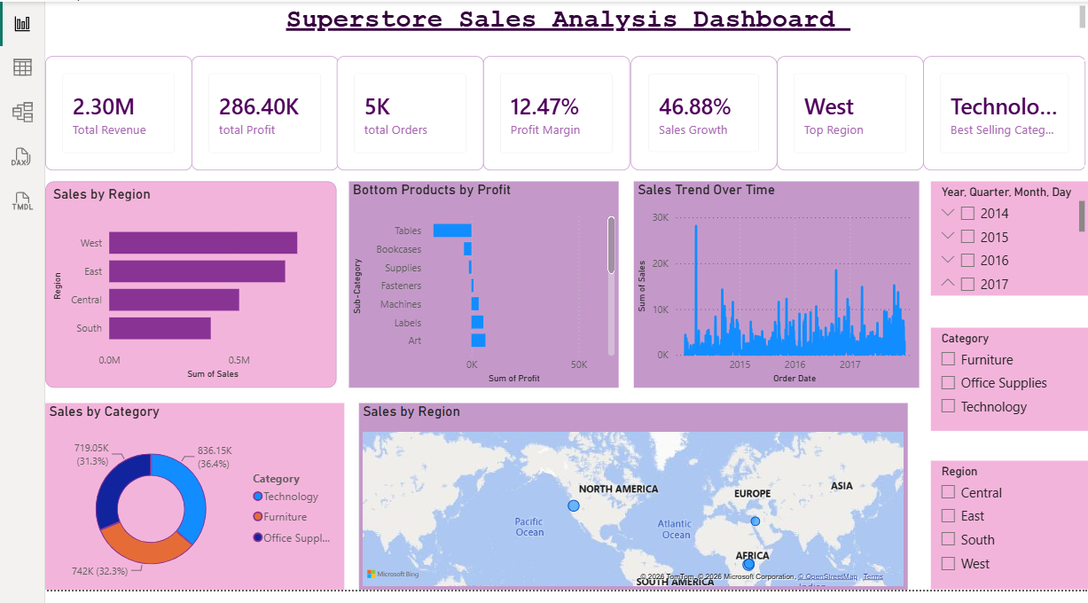
Dashboard Screenshot
POWER BI DASHBOARD
5

Slide 6
Key Insights
WHAT THE DASHBOARD REVEALS
1
West generated the highest sales.
2
Technology is the best-selling category.
3
Total revenue exceeded 2.30M.
4
Profit margin is approximately 12.47 %.
Some sub-categories such as Supplies and Fasteners generated low profits.
5
6

Slide 7
Recommendations
1
2
Focus on Technology products.
Improve the performance of underperforming products.
3
4
Increase marketing efforts in high-performing regions.
Review pricing strategies for low-profit products.
7

Slide 8
Challenges Faced
LEARNING CURVE ALONG THE WAY
Learning Power BI for the first time.
Creating DAX measures.
!
!
Designing an interactive dashboard.
Understanding relationships between KPIs and visuals.
!
!
8

Slide 9
CONCLUSION
From raw data to real decisions
This project helped me understand how to transform raw business data into meaningful insights using Power BI dashboards.
Muhira Mohammed Abdulrhman Ibrahim

